Slide 1
Random Forests in R
Examining Hazard Score and Health Score

Slide 2
Quick Refresher on Random Forest Results
There are three measures we will look at
Variable Importance Plots
Partial Dependence Plots
Correlation Plots
These measures need to be taken into consideration together, instead of each individually
For example, a Variable Importance Plot may be misleading if the variables of interest are highly correlated*

Slide 3
Quick Refresher Pt. 2
Through my research, I’ve found the ideal use for Random Forests is the following:
Providing insight into possible specifications for a model that has yet to be finalized
Verifying that a model is including variables that truly relate to the outcome
With Partial Dependence Plots, we can visualize if a relationship between our predicted and predictor variables is linear, exponential, etc.
We can also get a picture of over what range our predictors have an effect and possibly the degree of an effect

Slide 4
Limitations of Random Forests
The Variable Importance Plots will be misleading if too many predictors are correlated: one variable will seem to be very important, and will take some degree of importance from the next correlated variable, and so on
The X and Y axis of Partial Dependence Plots are very difficult to interpret. The shape is most often the most useful result from this test. Partial Dependence Plots are not affected by correlated variables.

Slide 5
Notes on the Following Analysis
In addition to using the stHealthScore and stHazScore and their five potential rankings for the Random Forest, I also made a dataset with 100 potential rankings of these two scores to see if this changed the outcomes at all.
For example, if we were to plot the new dataset like the normal EJSM, there would be 100 colors for each layer instead of just 5
Because there are more potential “buckets” for our predictions to fall into (and miss) we can expect error to rise, but we would like every other measure to stay more or less the same.
When possible, I will show the two side by side and offer an interpretation

Slide 6
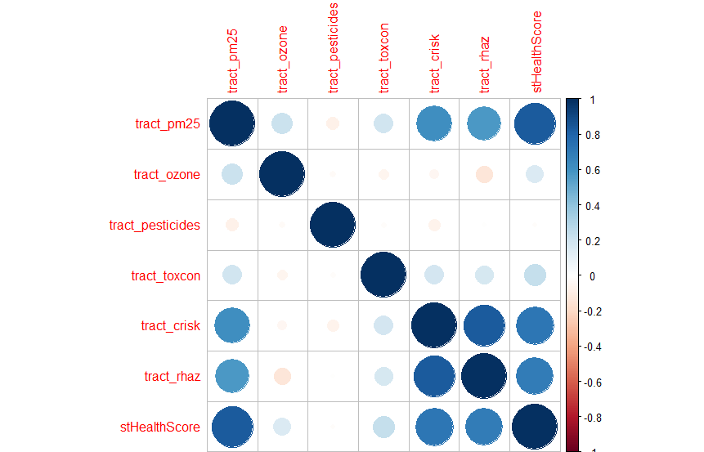

stHealthScore Results

Slide 7
stHealthScore Results
Naturally, the two correlation plots are identical
Every variable is correlated with the outcome with the exception of tract_pesticides
tract_crisk and tract_rhaz are both highly positively correlated with the outcome, but they are also correlated with each other. We might expect one variable to have a higher variable importance because one tract_crisk or tract_rhaz might “borrow” some of the other variable’s importance

Slide 8
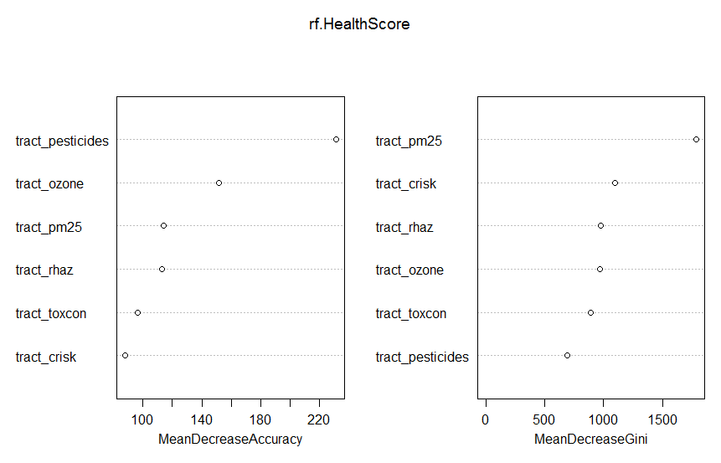
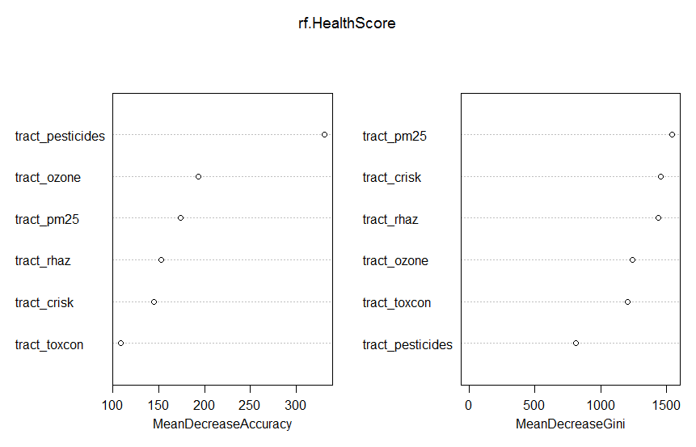
stHealthScore Results

Slide 9
MeanDecreaseAccuracy and MeanDecreaseGini
Though it might seem strange that pesticides tops the accuracy measure and is at the bottom of the Gini measure, it’s important to specify what each means
MeanDecreaseAccuracy gives us a measure of how much worse the model performs if a variable is removed from the model. In this case, is the most important variable in the model; if removed, our results would be far less accurate
MeanDecreaseGini measures how much better or worse our predictions are when we move a split on the tree. In this case, pesticides is vital to a good prediction, but there is likely a wide range of values pesticides can take that allow for good predictions, so moving the split is not as detrimental to our variable importance measure.

Slide 10
Summary of Variable Importance for stHealthScore
tract_crisk, tract_rhaz, and pm25 are correlated, so it is possible that each variables true importance is being obscured by the other’s presence. However, pesticides does not suffer from the same problem, so I feel comfortable emphasizing how important pesticides is to the stHealthScore result.
The variables in question are far from being too correlated to make the variable importance measure useless, but another recommendation I feel comfortable making based on these results is that if similar measures with less correlation could be found and collected at a lower cost, that would likely improve the quality of the stHealthScore measure and save resources.

Slide 11
Partial Dependence Plot Definitions
Partial Dependence Plots (PDP) or Marginal Dependence are formed by taking the average predicted draw at each value of the predictor averaged across the rest of the other predictors.
I will discuss some of the usefulness of PDP’s later, but it is the shape of the PDP that is most vital. The x-axis will typically take the range of the predictor variable, but the y-axis is much more difficult to interpret, so one must be careful not to draw too many conclusions from one PDP.
Do note that as the values increase along the x-axis in the following graphs, the y-axis takes a lower value. This can be clearly interpreted as our Health Score dropping as our pollutants, hazards, etc. increase.

Slide 12
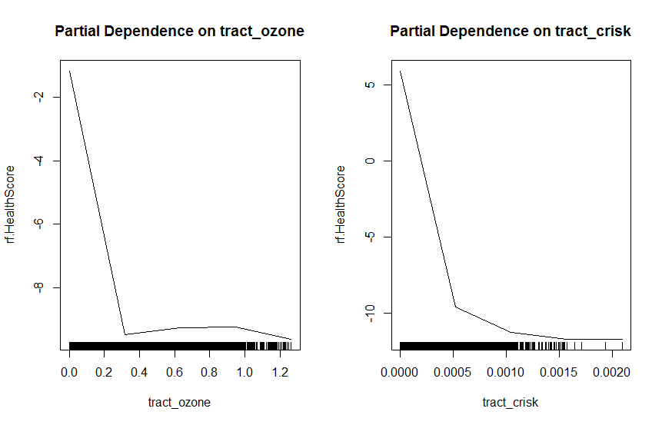
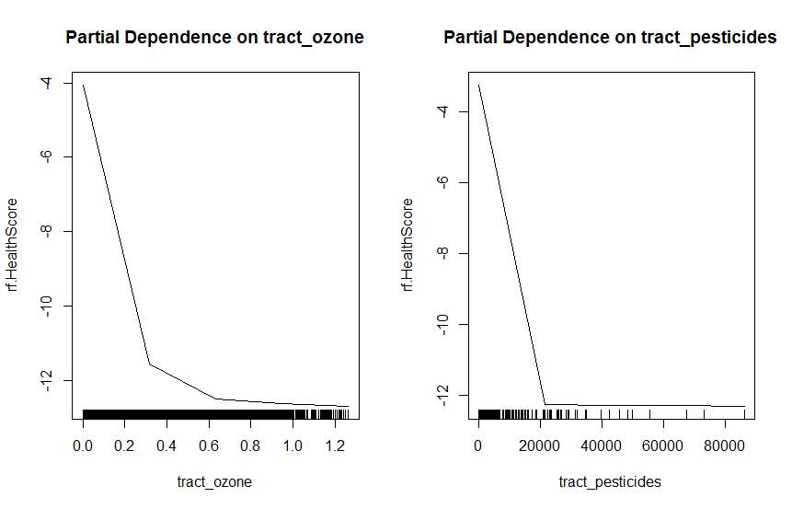
Partial Dependence Plots

Slide 13
Partial Dependence Plots Pt. 2
As I mentioned before, I made another dataset with 100 ranks instead of 5, which allows the health score to be treated more like a continuous variable. In the 5 rank tract_ozone, we see a small increase after a sharp decrease, which is not present in the 100 rank tract_ozone plot. Transformations of the dependent variable such as this can help correct or expose strange variable activity.
Remember that the usefulness of RF’s lie in data exploration. Though cutting outliers can be a tricky business when performing a rigorous regression, you can see here that many variables flatline as they move towards the right.

Slide 14
Partial Dependence Plots Pt. 3
Eliminating outliers can often better reveal the shape of the partial dependence plot, and is not discouraged like it might be with other methods of analysis.
It should also be noted that by running more trees in the RF calculation, you can sometimes smooth a curve, though in this case I ran 500 OOB samples. Both PDP’s show a jump at about .3 in tract ozone. Whether this is an issue of common levels, measurement capabilities, or elements of randomness, this is another example of the type of data a RF reveals.

Slide 15
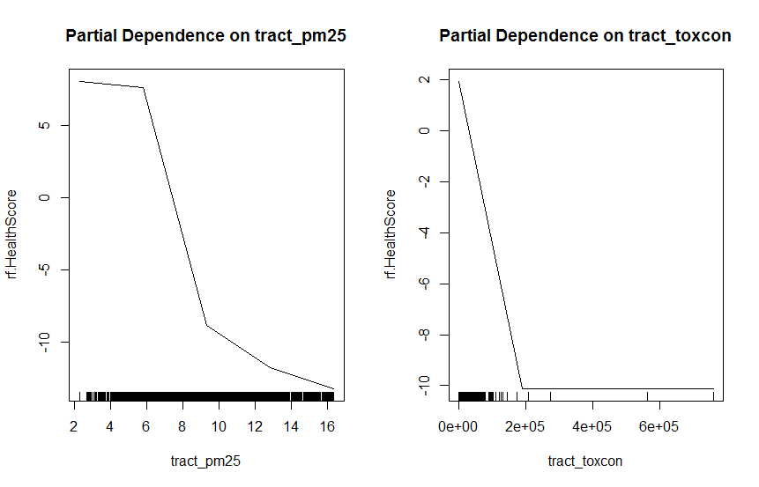
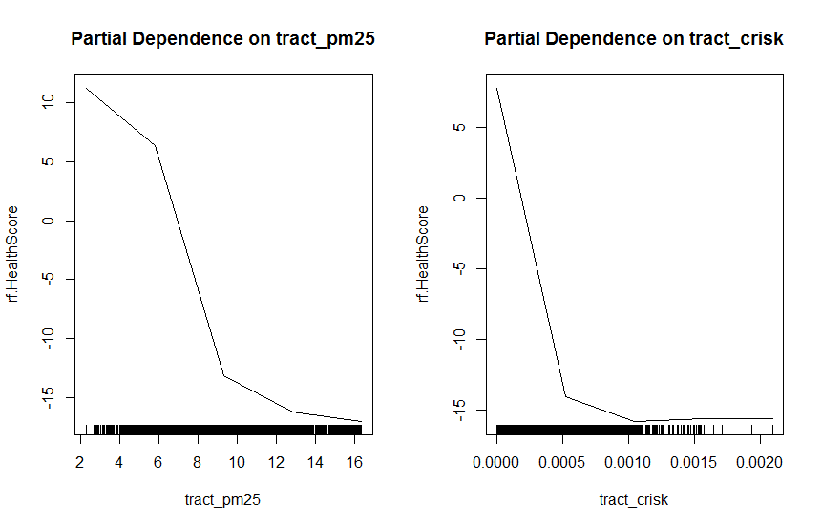
PDP for PM 25

Slide 16
More stHealthScore PDP Interpretations
One interesting thing to note is that PM25 has a sigmoidal curve, suggesting a log, logit, or probit approach might be effective. While in the context of developing a ranking such a transformation would not be useful, in developing a regression, such a shape would save a great deal of exploratory effort.

Slide 17
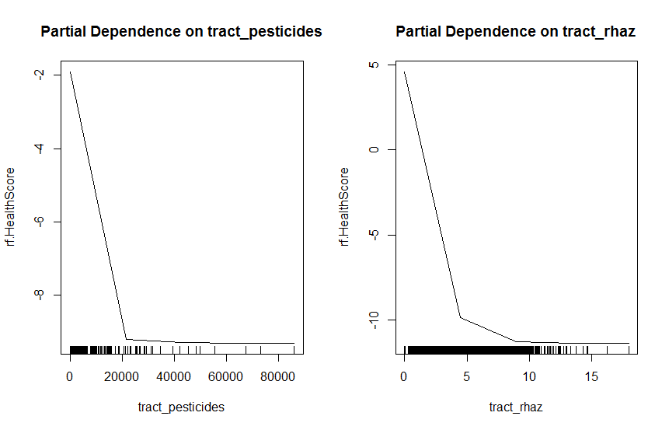
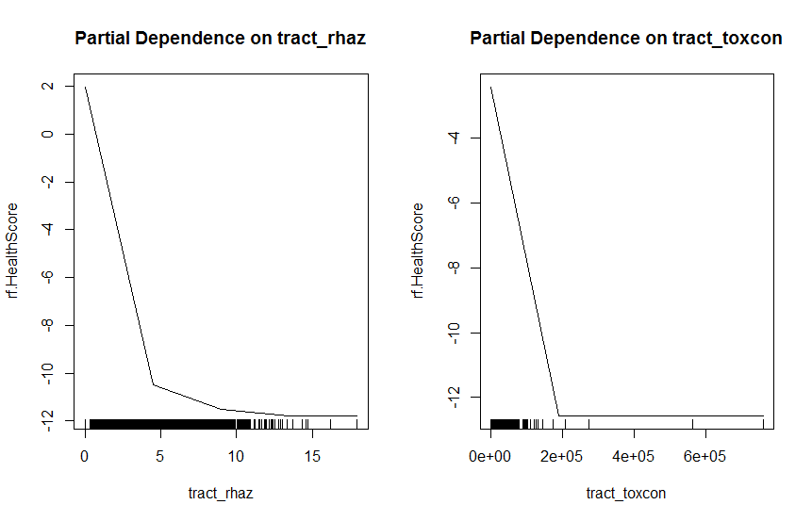
More stHealthScore PDP Interpretations

Slide 18
Summary of stHealthScore
Finally, our last two graphs are consistent with our previous graphs. As it is meanDecreaseAccuracy that is our most important variable importance measure, and we saw consistent results in the 5 and the 100 ranking, most variables should clearly be included in the model. It is questionable that tract_crisk should be, given that it comes in low twice in meanDecreaseAccuracy (which again means that removing it from the model does less to make the predictions less accurate), because it does have a high value in meanDecreaseGini, and also the correlation between tract_crisk and other variables may be obscuring it’s true variable importance.

Slide 19
Summary of stHealthScore Pt. 2
However, tract_toxcon performs poorly in every variable importance measure, and is not highly correlated with any other measure. If one wanted to simplify the model, or found the data to expensive to collect, it would be my suggestion to drop this variable. If running a regression, the introduction of bias into the error term would be smallest by dropping this variable, and finally, the extremely large range this variable takes on, while appearing to be linear, might still introduce difficulty with outliers or tracts getting more weight than they ought to.

Slide 20
stHazScore
I have covered many of the things to look for in the previous section, so I will be more brief in those areas, but there are significant differences between this score and the previous, so I will be focusing on those.

Slide 21
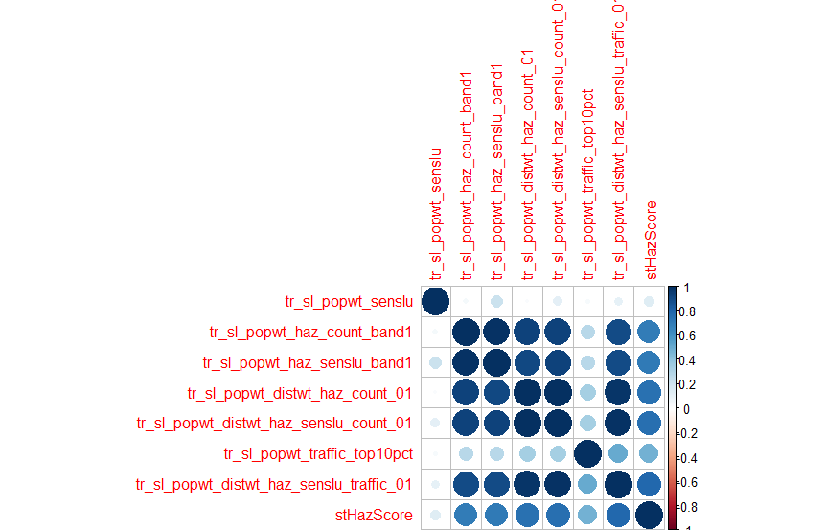

stHazScore Correlation Plot

Slide 22
High Correlation in stHazScore Variables
It’s clear that most of the variables used to calculate this score are heavily correlated. This is the type of correlation matrix that warrants taking the VIP with a bit more skepticism.
We can see tr_sl_popwt_senslu and tr_sl_popwt_traffic_top10pct are the least correlated in the group, so we can be a bit more trusting of their standing in the plot.

Slide 23
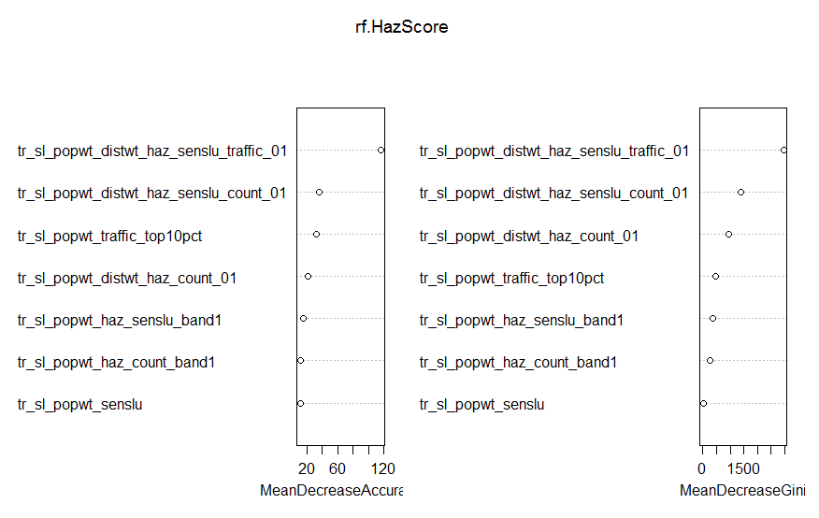
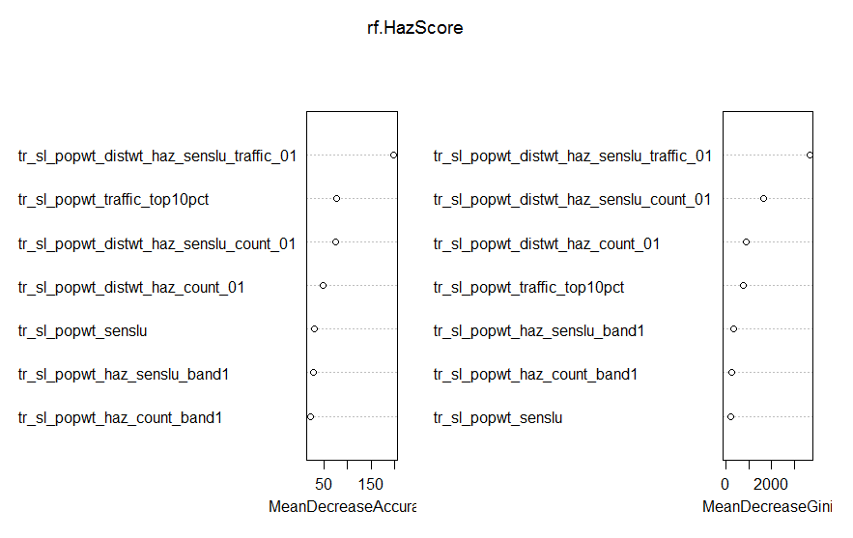
stHazScore Variable Importance Plot

Slide 24
Variable Importance Plot Interpretation
Unfortunately, this VIP is going to be less clear. There are a few generalizations we can make, however.
Remember that having correlated variables fairly accurately states the importance of one correlated variable, then “robs” some of the importance of the following correlated variables.
Population weighted sensitive land use does not perform well in these plots, and could be a good contender for removal.
One good insight is that distance weighted measures perform better than populations weighted measures in accurately predicting the outcome of stHazScore

Slide 25
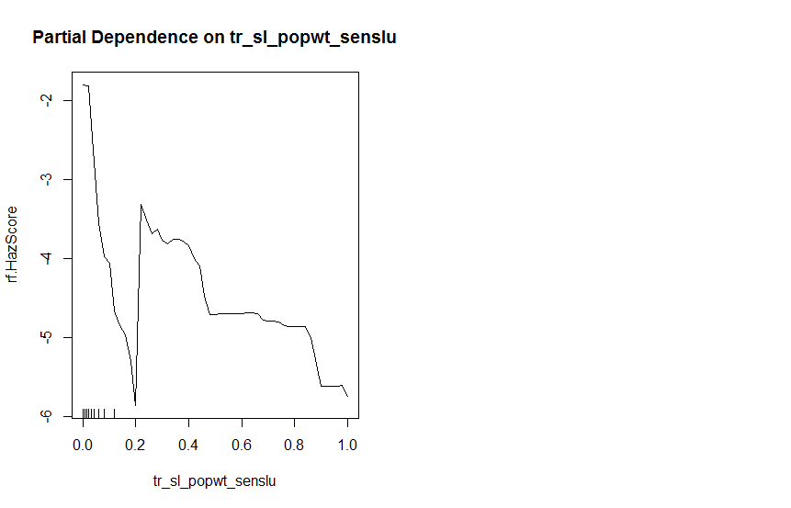
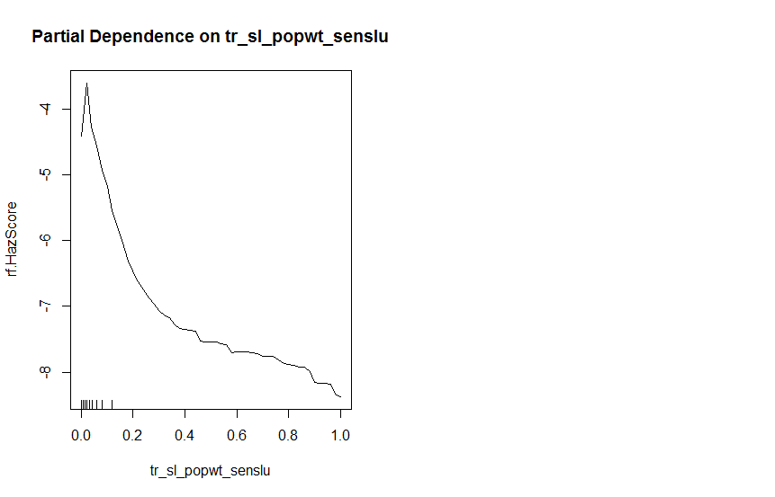
tr_sl_popwt_senslu

Slide 26
tr_sl_popwt_senslu PDP Interpretation
In my opinion, this is one of the best examples of doing the 5 rank and 100 rank. It does not make intuitive sense to me that there would be a sharp drop followed by a sharp increase as sensitive land uses in a tract increase.

Slide 27
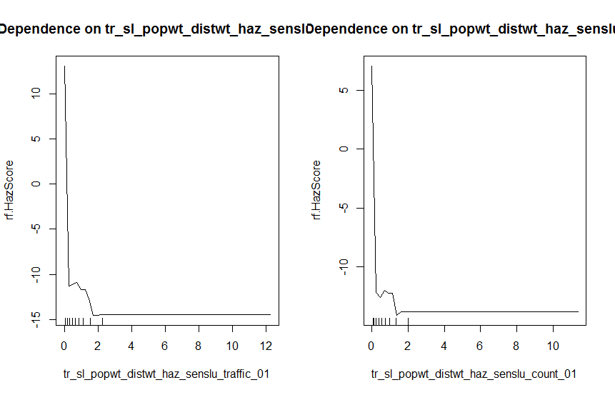
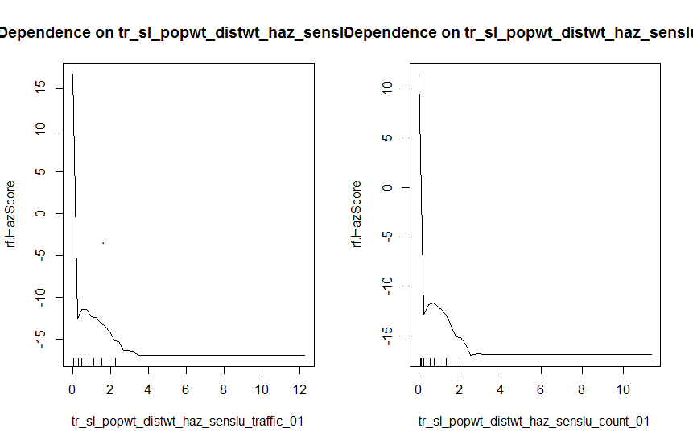
Distance weighted traffic and senslu vars

Slide 28
Interpretation
We already know these variables are useful, but here we can see by its shape that there are some outliers on the left and likely missing or low values on the right. Both the 5 and 100 rank have very similar shapes, so this would be a case where cutting out the left and right tails would tell us more about what these variables are doing where they between the values of 0 and 2.

Slide 29
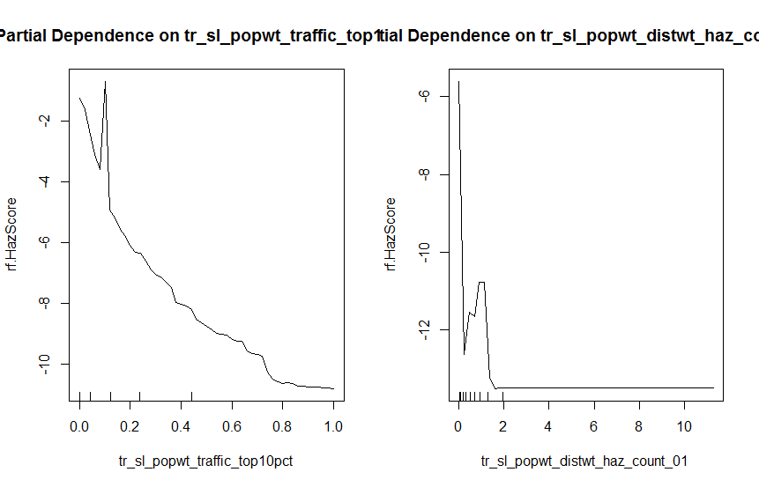
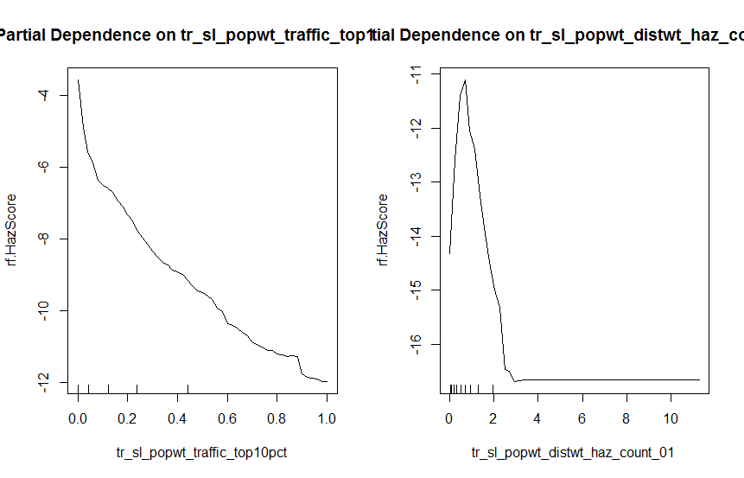
Top 10pct Traffic and HazCount

Slide 30
Top 10pct Traffic and HazCount Interpretation
There are more peaks at the .2/2 level, though more pronounced in the 100 rank plot. Unfortunately, I don’t have access to all the original datasets, but this might turn up something interesting.

Slide 31
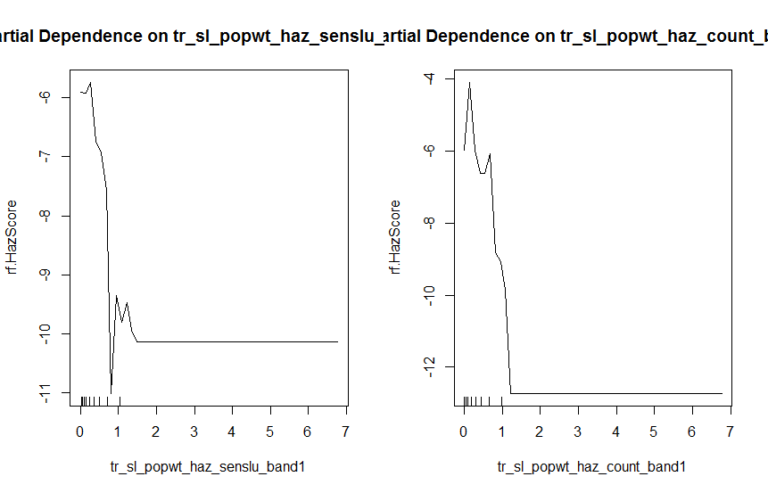
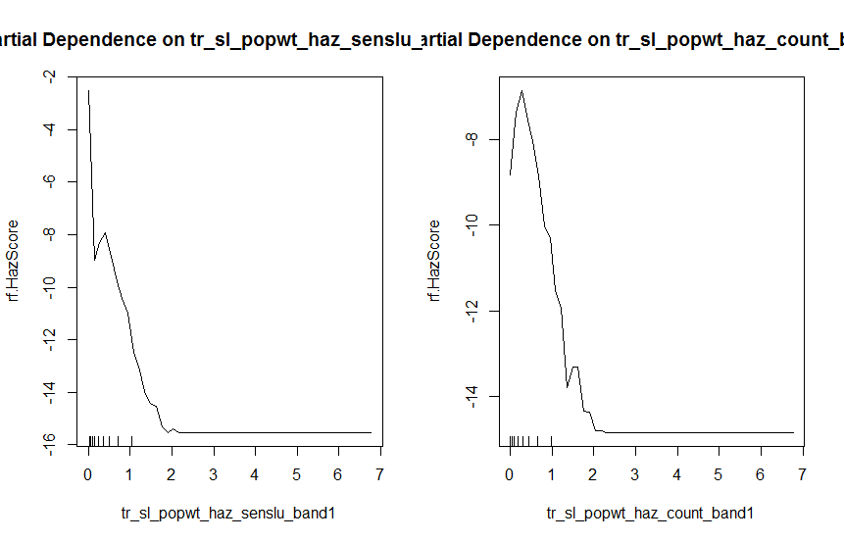
Pop weighted senslu and hazcount

Slide 32
Final Interpretation
These shapes are very similar to many of the previous variables we’ve looked at. It’s not unexpected that they would move together given the high level of correlation.
In my estimation, the correlation and variable importance plots provided the most important information; distance weighting influences the end rankings more than those that are just population weighted. If I remember correctly, the distance weighting required ArcGIS distance banding, which was likely time intensive, but calculating the population weighted variables takes only a little more effort, so eliminating them would be unwise. tr_sl_popwt_senslu would probably be the only variable that could be dropped and affect the ranking outcome as little as possible.

Slide 33
Summary
More in-depth information is provided in the documentation and VIP .doc, but this ideally provided a good visual example of how to interpret some of the RF results. There are other tests and plots that can be made, but these three plots, taken in conjunction with each other, tell us a great deal about what should and shouldn’t be included in a model. Finally, even though this was a good test of what variables were the most and least important in the EJSM ranking, I hope that its usefulness in creating a regression or other type of model has been shown as well.

